Slide 1



ADVENTURE AWAITS
ADVENTURE
ACTIVITY BOOKING
-Ishan Saxena

Slide 2

PROJECT OVERVIEW
Our project aims to develop a comprehensive adventure booking platform that connects thrill-seekers with exciting activities around the globe. Leveraging the power of modern technology, we seek to streamline the process of discovering, booking, and sharing adventurous experiences. Through intuitive interfaces and robust backend systems, users will have access to a diverse range of activities, from mountain trekking to scuba diving, all in one centralized platform.

Slide 3

TECHNOLOGIES AND FRAMEWORKS USED
Frontend: Angular framework for building the user interface.
Backend: Java programming language, Spring Boot framework for creating microservices.
Microservices: API gateway, Service Registry and configuration management.
Database: MySQL and MongoDB for storing user data, activity details, booking information and reviews.

Slide 4
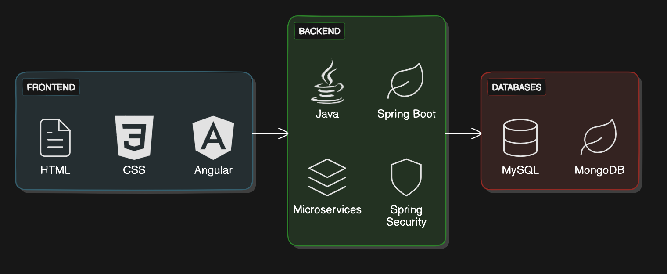

Slide 5
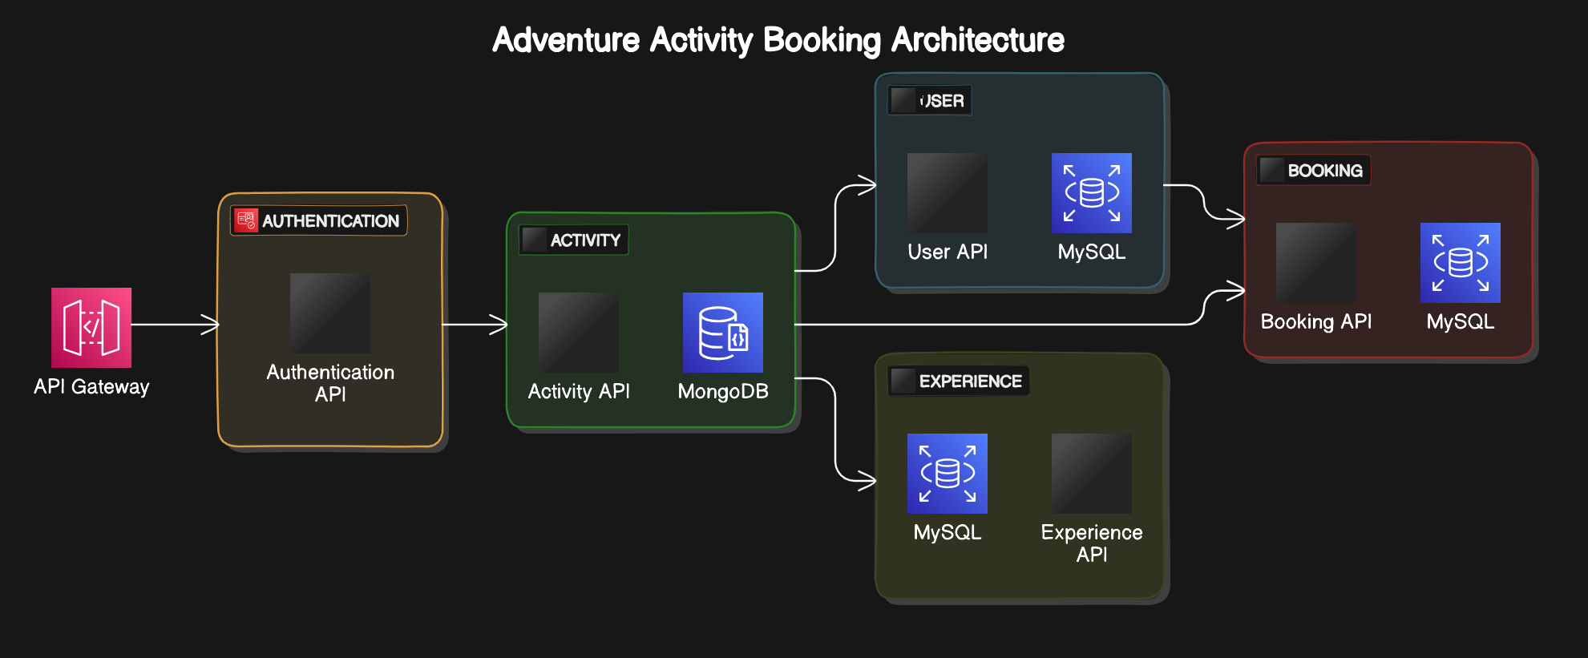
PROJECT FLOW

Slide 6


MICROSERVICES
1
User Service
2
Experience Service
3
Booking Service
4
Notification Service
5
Authentication Service

Slide 7
ROLES
1
Customer
2
Expert
Admin
3

Slide 8
AUTHENTICATION MICROSERVICE
1.LOGIN AND SIGNUP:
MANAGES SECURE LOGIN AND SIGNUP FUNCTIONALITIES
2.TOKEN GENERATION:
CREATES A SECURE TOKEN WITH EMAIL, USERID, AND ROLE
3.ROLE-BASED ACCESS:
ADMINS: VIEW ALL USERS ETC.
EXPERTS: MANAGE ACTIVITIES ETC.
CUSTOMERS: BOOK ACTIVITIES ETC.

Slide 9

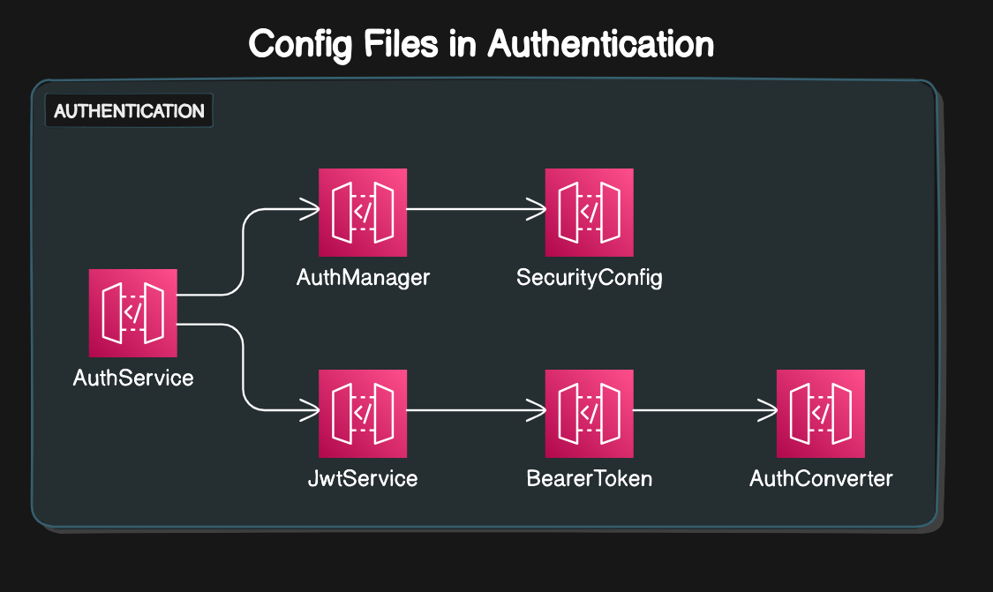


Slide 10
USER MICROSERVICE
1.USER REGISTRATION:
REGISTER AS CUSTOMERS, EXPERTS, OR ADMINS
2.User Management:
Edit, delete, and fetch personal details
3.Admins can view and manage all user accounts
4.Data Storage : MySQL

Slide 11
ACTIVITY MICROSERVICE
1.EXPERT FUNCTIONS: ADD, UPDATE, AND DELETE ACTIVITIES
2.Admin Visibility: Full access to all activities
3.Customer Interactions:
Book activities effortlessly
4.Homepage Customization:
Customers & Admins: View activities as cards
Experts: View their listed activities
5.Data Storage : MongoDb

Slide 12
BOOKING MICROSERVICE
1.CUSTOMER ACTIONS:
EASILY BOOK OR CANCEL ACTIVITIES
2.Expert Access:
View bookings for their listed activities
3.Admin Oversight:
View all bookings
Filter by specific activities
View individual customer bookings
4.Data Storage : MySQL

Slide 13
EXPERIENCE MICROSERVICE
1.CUSTOMER INTERACTIONS:
Write and update comments and ratings (1-5)
for activities
2.Expert Oversight:
View all experiences for their listed activities
3.Admin Management:
View all experiences across all activities
4.Data Storage: MongoDB database

Slide 14
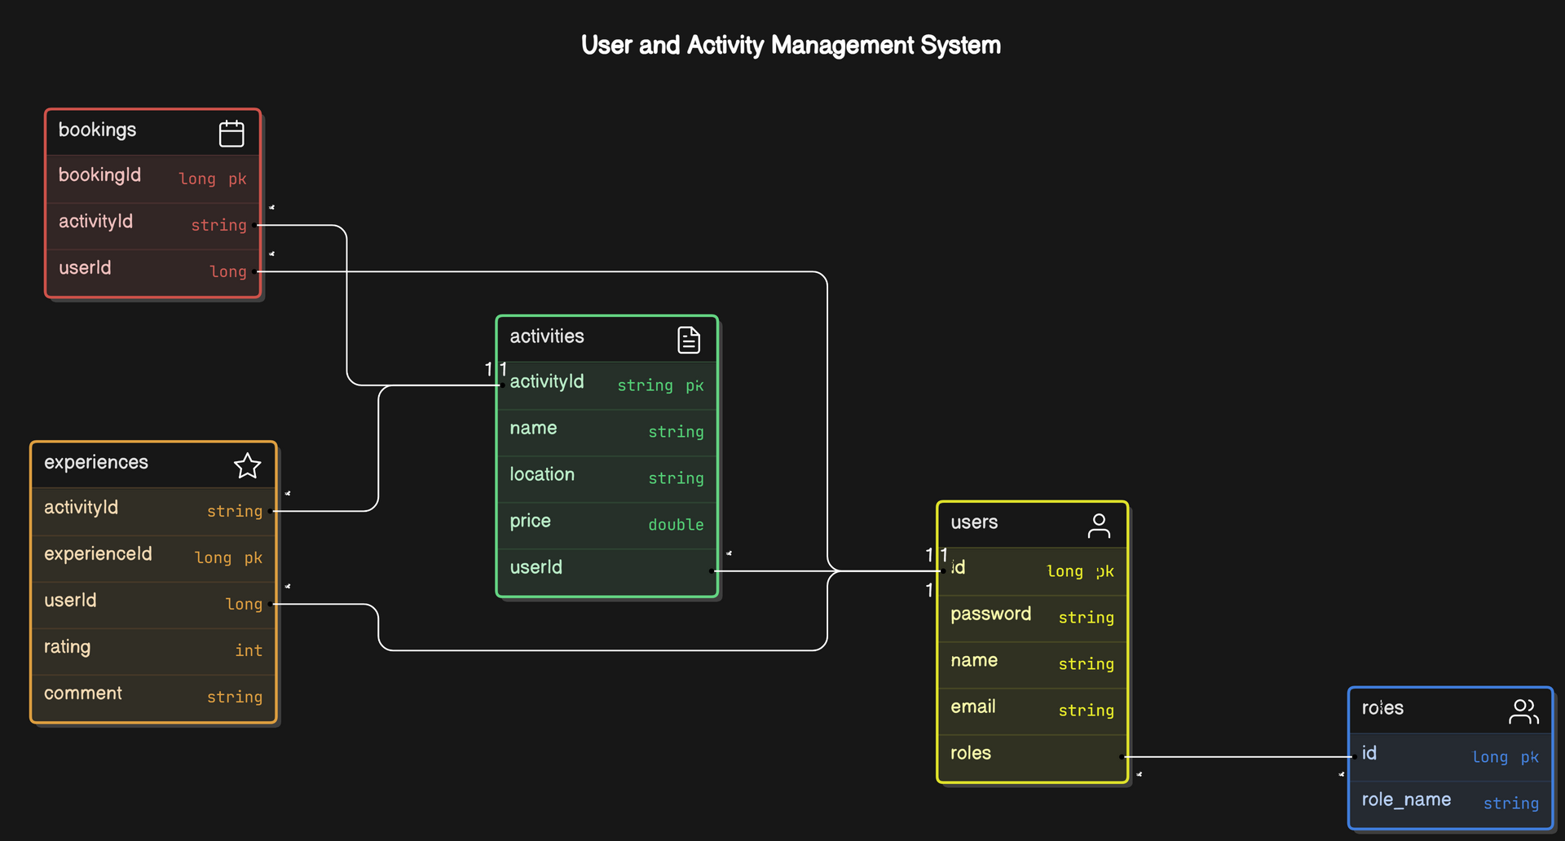
DATABASE DIAGRAM

Slide 15
THANK
YOU

